Slide 1
Overview of the LF Deep Learning Foundation
Ibrahim Haddad, Ph.D. – Executive Director
@IbrahimAtLinux
This presentation is available at:
https://github.com/LFDLFoundation/presentations

Slide 2
What is LF DL Foundation?
LF DL is a Linux Foundation project founded in March 2018 to support collaboration and open source innovation in the AI, ML, and DL domains.
LF DL members are collaborating to create a neutral space for harmonization and acceleration of separate technical projects focused on AI, ML, and DL technologies.

Slide 3

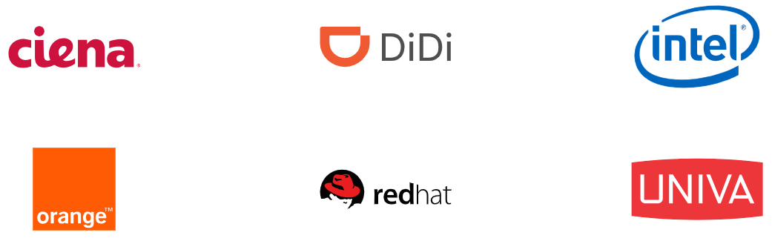
Current Members

Slide 4


LF DL: Creating a Sustainable Open Source AI Ecosystem
PROJECTS
Successful open source projects depend on members, developers, standards and infrastructure to develop products that the market will adopt.
DEVELOPER
COMMUNITY
TECHNOLOGY
PARTICIPATION
PRODUCTS
MARKETS
PROFITS
PRODUCTS

Slide 5
Mission
Build and support an open community of data scientists, researchers, and developers focused on AI, ML, and DL, and drive open source innovation in these domains by enabling collaboration and the creation of new opportunities for the community and their supporting organizations.

Slide 6
Strategic Goals
Offer a neutral environment that fosters collaboration and cross-pollination between open source projects focused on AI/ML/DL
Increase efforts to harmonize AI/ML/DL open source projects and reduce fragmentation
Become the home of open source efforts for AI ethics and fairness
Host open source data lakes and offer a marketplace for AI/ML/DL models
Increase awareness of key AI/ML/DL open source projects and increase the ease of use of these projects

Slide 7




Current Projects
AI model workflow and discovery platform.
A high-performance distributed machine-learning platform based on Parameter Server, running on YARN and Apache Spark.
A framework designed to help deep learning cloud service providers to build cluster cloud services using different deep learning frameworks.
Distributed training framework for TensorFlow, Keras, and PyTorch.

Slide 8
2018 Major Milestones
LF DL is launched drive open source growth in AI
LF DL publishes “Open Source AI: Projects, Insights and Trends”
LF DL announces project lifecycle and contribution process
LF DL welcomes 2 new incubation projects: Angel ML (Tencent) and EDL (Baidu)
LF DL hosts Acumos AI Days in NYC
LF DL announces its AI/ML/DL Landscape
MARCH
APRIL
MAY
JUNE
JULY
AUGUST
OCTOBER
NOVEMBER
DECEMBER
LF DL Infrastructure is established to enable code development
LF DL announces “Acumos AI Challenge” for developers
LF DL hosts Acumos AI Days in Chatillon (France)
LF DL hires Ibrahim Haddad as Executive Director
“Athena”, the first Acumos AI release making it easier to deploy and share AI models
Development on the “Boreas” release kicks off
UBER contributes Horovod as an incubation project

Slide 9
Governance and Structure 1/2
LF DL is a single funding effort to support technical projects hosted under in the Foundation.
Technical projects have their own technical governance following our principle of separation of technical governance from funding governance.
The Foundation’s Charter is available from https://lfdl.io.

Slide 10
Governance and Structure 2/2
Project Coordination
Funding Governance
Technical Oversight
Governing Board
Technical Advisory Council
Acumos
EDL
Angel
Horovod
Outreach
Legal
Budget
Dev Community
Dev Community
Dev Community
Dev Community

Slide 11
Hosting Projects the under LF DL: Project Contribution Process https://github.com/LFDLFoundation/proposing-projects

Slide 12
On-boarding Projects into LF DL
Projects are on-boarded and progress pursuant to the LF Deep Learning Foundation’s Lifecycle and Project Contribution Process Documents.
Three stages: Incubation, Graduation and Archive.
These documents can be found on GitHub.

Slide 13
LF DL Project Maturities
Incubation projects
Projects join LF DL as incubation by meeting the requirements set forth in the “Project Lifecycle Document”.
TAC Vote.
Graduate projects
Incubation requirements.
Additional requirements as set in the “Project Lifecycle Document”.
TAC Vote + GB Vote.

Slide 14
Criteria to Accept Incubation Project Under LF DL
Submit a completed Project Contribution Proposal to the TAC
Process and proposal are available on Github and on the LF DL web site
Present the project and the proposal to the TAC and, if requested, to the Governing Board
Be deemed by the TAC and Governing Board to fall within the mission and scope of LF DL Foundation and to add value to the AI/ML/DL space
Have an OSI-approved open source license
Agree to transfer any relevant trademarks to The Linux Foundation or its affiliate, LF Projects, LLC, and to assist in filing for any relevant unregistered ones

Slide 15
Criteria to Accept Graduation Project Under LF DL
In addition to the Incubation stage requirements, a project must meet these requirements:
Have a healthy number of committers from at least two organizations*
Have achieved and maintained a Core Infrastructure Initiative Best Practices Badge
Demonstrate a substantial ongoing flow of commits and merged contributions
Document current project owners and current and emeritus committers in OWNERS.md and COMMITTERS.md files
A copy of the project’s charter (or other governance document) shall be included or linked to in a GOVERNANCE.md or in a similar file
Have a technical lead appointed for representation of the project to the TAC
Receive the affirmative vote of 2/3 of the TAC and the affirmative vote of the Governing Board

Slide 16

LF Deep Learning has a modular approach to hosting projects.
Think of LF Deep Learning as a greenhouse growing and sustaining open source AI/ML/DL projects from seed to fruition. The Linux Foundation and LF Deep Learning provide the infrastructure and support for open development to occur among a diverse and thriving community, in addition to a number of enabling services (legal, PR/marketing, events, compliance scans, etc.).

Slide 17
Benefits of Hosting Projects at the LF DL Foundation
Maintain your committers and define your own project governance (as long as its neutral)
A not-for-profit, neutral home increases contributions from external organizations
LF DL staff eager to assist (ED, PM, IT staff, PR, marketing, events, etc.)
LF DL blog announcement or similar announcing the inclusion of the project
Infrastructure resources (wiki, build, jira, mailing lists, support staff, etc.)
Neutral hosting of the project’s trademark
An initial license scan of the project’s codebase
Cross pollination opportunities with other LF DL projects
Endorsement by LF DL TAC - Appointment of an existing TAC member as a sponsor of the project and provide recommendations regarding governance best practices
Right to refer to the project as a “LF Deep Learning Foundation Project,” with the right, subject to applicable trademark usage guidelines, to display the Deep Learning logo on the project’s code repository
Graduation stage may receive support as determined by the Governing Board

Slide 18
Contact Us!
LF DL is actively reaching out to open source AI/ML/DL projects for contribution and collaboration. If you have a project that could benefit from:
Community building
Marketing and brand outreach strategies
Developer support
Collaboration with other projects
Please reach out to us!
info@lfdl.io
@IbrahimAtLinux

Slide 19
Joining the LF Deep Learning Foundation

Slide 20



Membership Benefits
Organizations join LF DL because they want to take an active role in supporting the growth and evolution of the open source AI/ML/DL ecosystem.
LF DL Membership Provides:
1
2
3
Marketing Amplification
and Brand Awareness
Community Engagement
Thought Leadership

Slide 21
LF Deep Learning Foundation Annual Dues
Not Yet a Linux Foundation Member
Existing Linux Foundation Member
Premier Member
$120,000
$100,000
General Member
5,000 employees +: $45,000
2,000 - 4,999: $30,000
500 - 1,999: $25,000
Up to 499 employees: $10,000
5,000 employees +: $25,000
2,000 - 4,999: $15,000
500 - 1,999: $10,000
Up to 499 employees: $5,000

Slide 22
General Membership
Targeted for organizations that want to put their organization in full view in support of LF DL and our mission. Organizations that join at the General level are deeply committed to using open source technology, helping LF DL grow, voicing the opinions of their customers, and giving back to the community.
General members are eligible to:
Participate in elections to appoint one (1) representative to the LF DL Governing Board per every ten (10) General members, up to three (3) maximum General representatives.
Receive greater insight into LF DL strategy and project roadmaps through increased engagement with the LF DL Executive Director and staff.
Create an individualized press release upon membership announcement with the LF DL PR team.
Participate in all Marketing, Community, Thought Leadership opportunities.
Demonstrate your support for LF DL by displaying your logo on the LF DL website and in marketing materials.

Slide 23
Premier Membership
Highest tier of membership – For organizations who contribute heavily to open source AI, ML and DL and bring in their own projects to be hosted at the Foundation. They work in concert with LF DL + LF team members. These companies want to take the most active role in enabling open source AI, ML and DL.
Premier members are eligible to:
(Enjoy all the benefits of General level, plus;)
Appoint one (1) representative to the LF DL Governing Board.
Appoint one (1) representative as a voting member in any subcommittees or activities of the Governing Board.
Enjoy most prominent placement in displays of membership including on the website and in marketing materials.
Increased access to Linux Foundation’s invitation-only Open Source Leadership Summit.
Create an individualized press release upon membership announcement with the LF DL PR team.
Receive ongoing, individual engagement and guidance from LF DL Executive Director and staff.

Slide 24
Interactive AI/ML/DL Landscape

Slide 25
LF Deep Learning Foundation – Interactive Landscape
This landscape is intended as a map to explore open source artificial intelligence, machine learning, and deep learning projects; it also features the member companies of the LF Deep Learning Foundation.
https://l.lfdl.io
Please open a pull request to correct any issues.

Slide 26
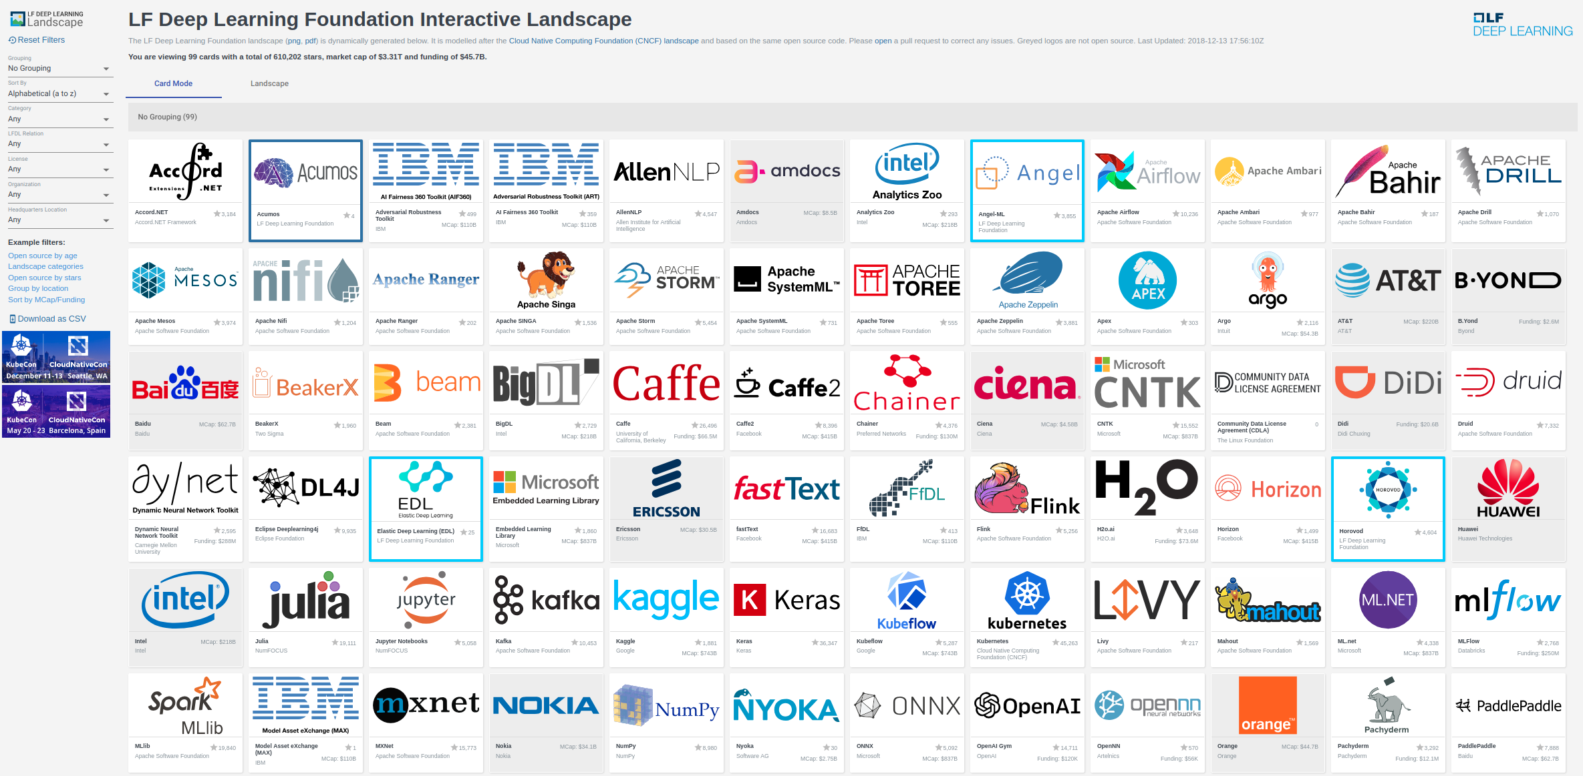
Try it: l.lfdl.io

Slide 27
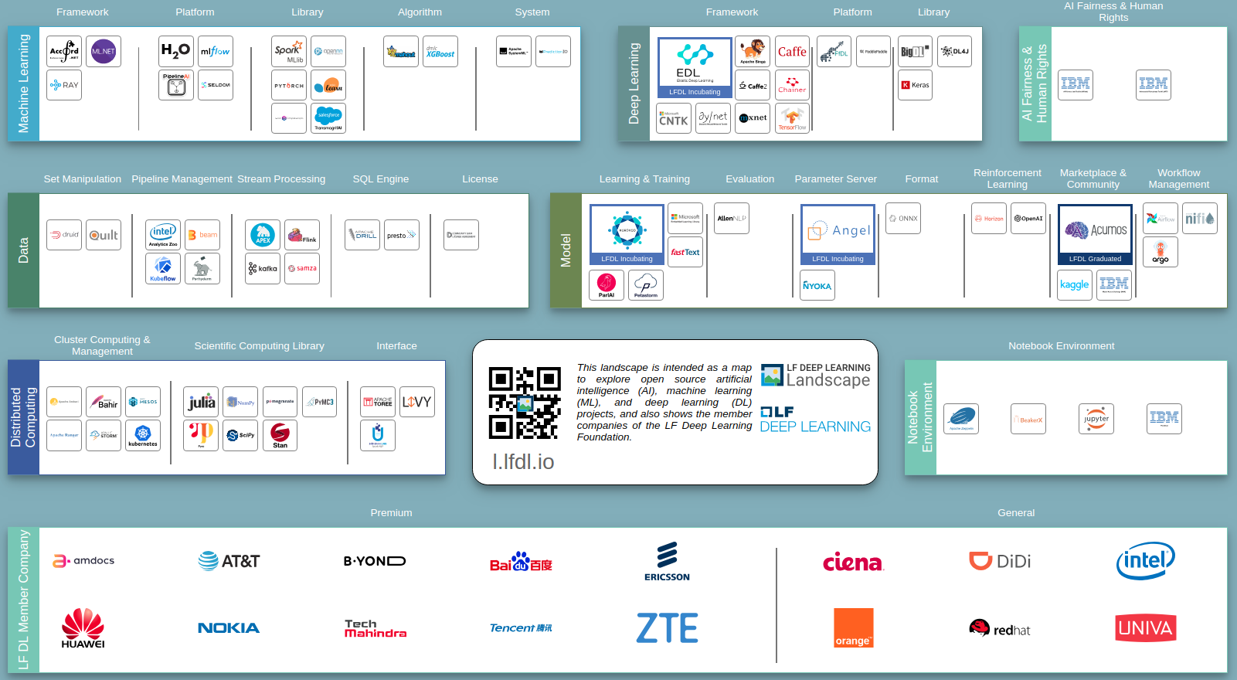

Slide 28
Joining LF DL Foundation is easy. Join today!
Please follow up with Ibrahim Haddad Ibrahim@LinuxFoundation.org
or
info@lfdl.io

